Slide 1




Understanding Pathways through Perturbations
Herbert Sauro
University of Washington
Seattle, WA

Slide 2
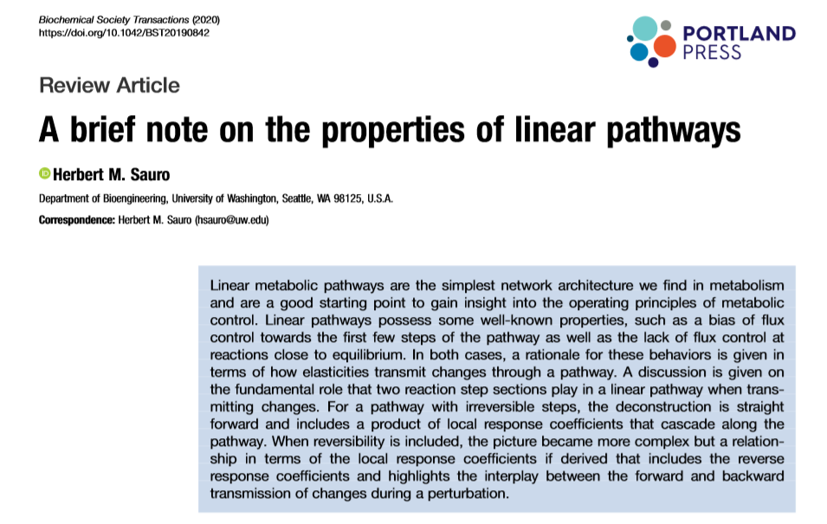
Based on the following paper:
Gives a review of the field and
ways to describe the dynamics
of a network in a hierarchical manner.
Sauro, H.M., 2020. A brief note on the properties of linear pathways. Biochemical Society Transactions, 48(4), pp.1379-1395.

Slide 3
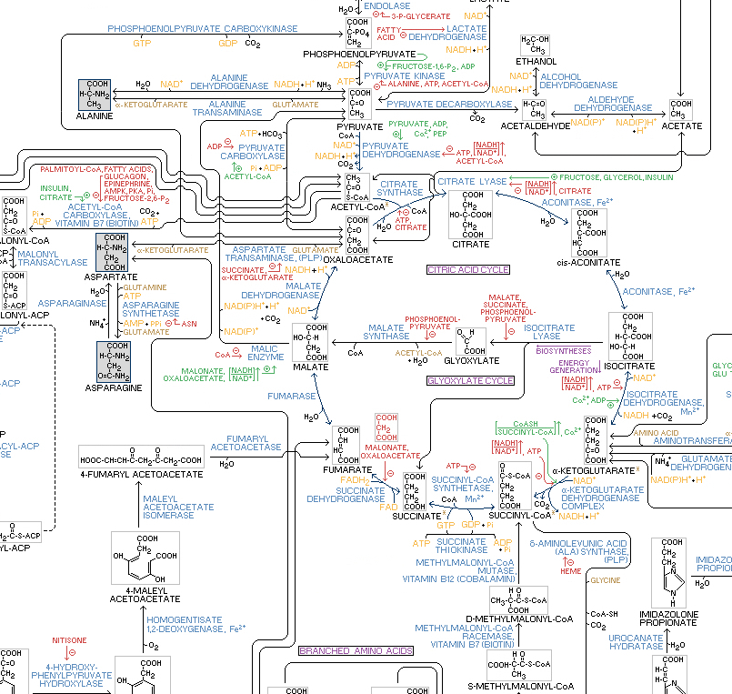
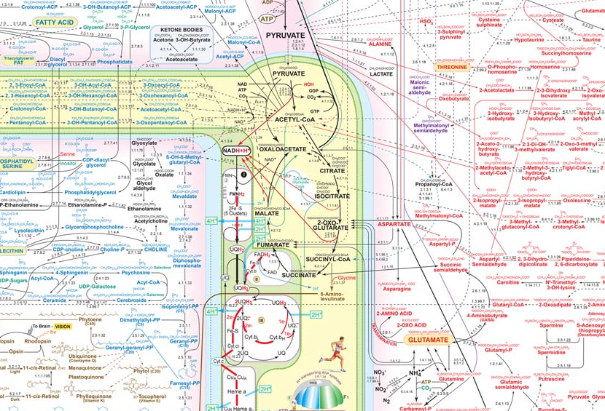
Traditional Views

Slide 4
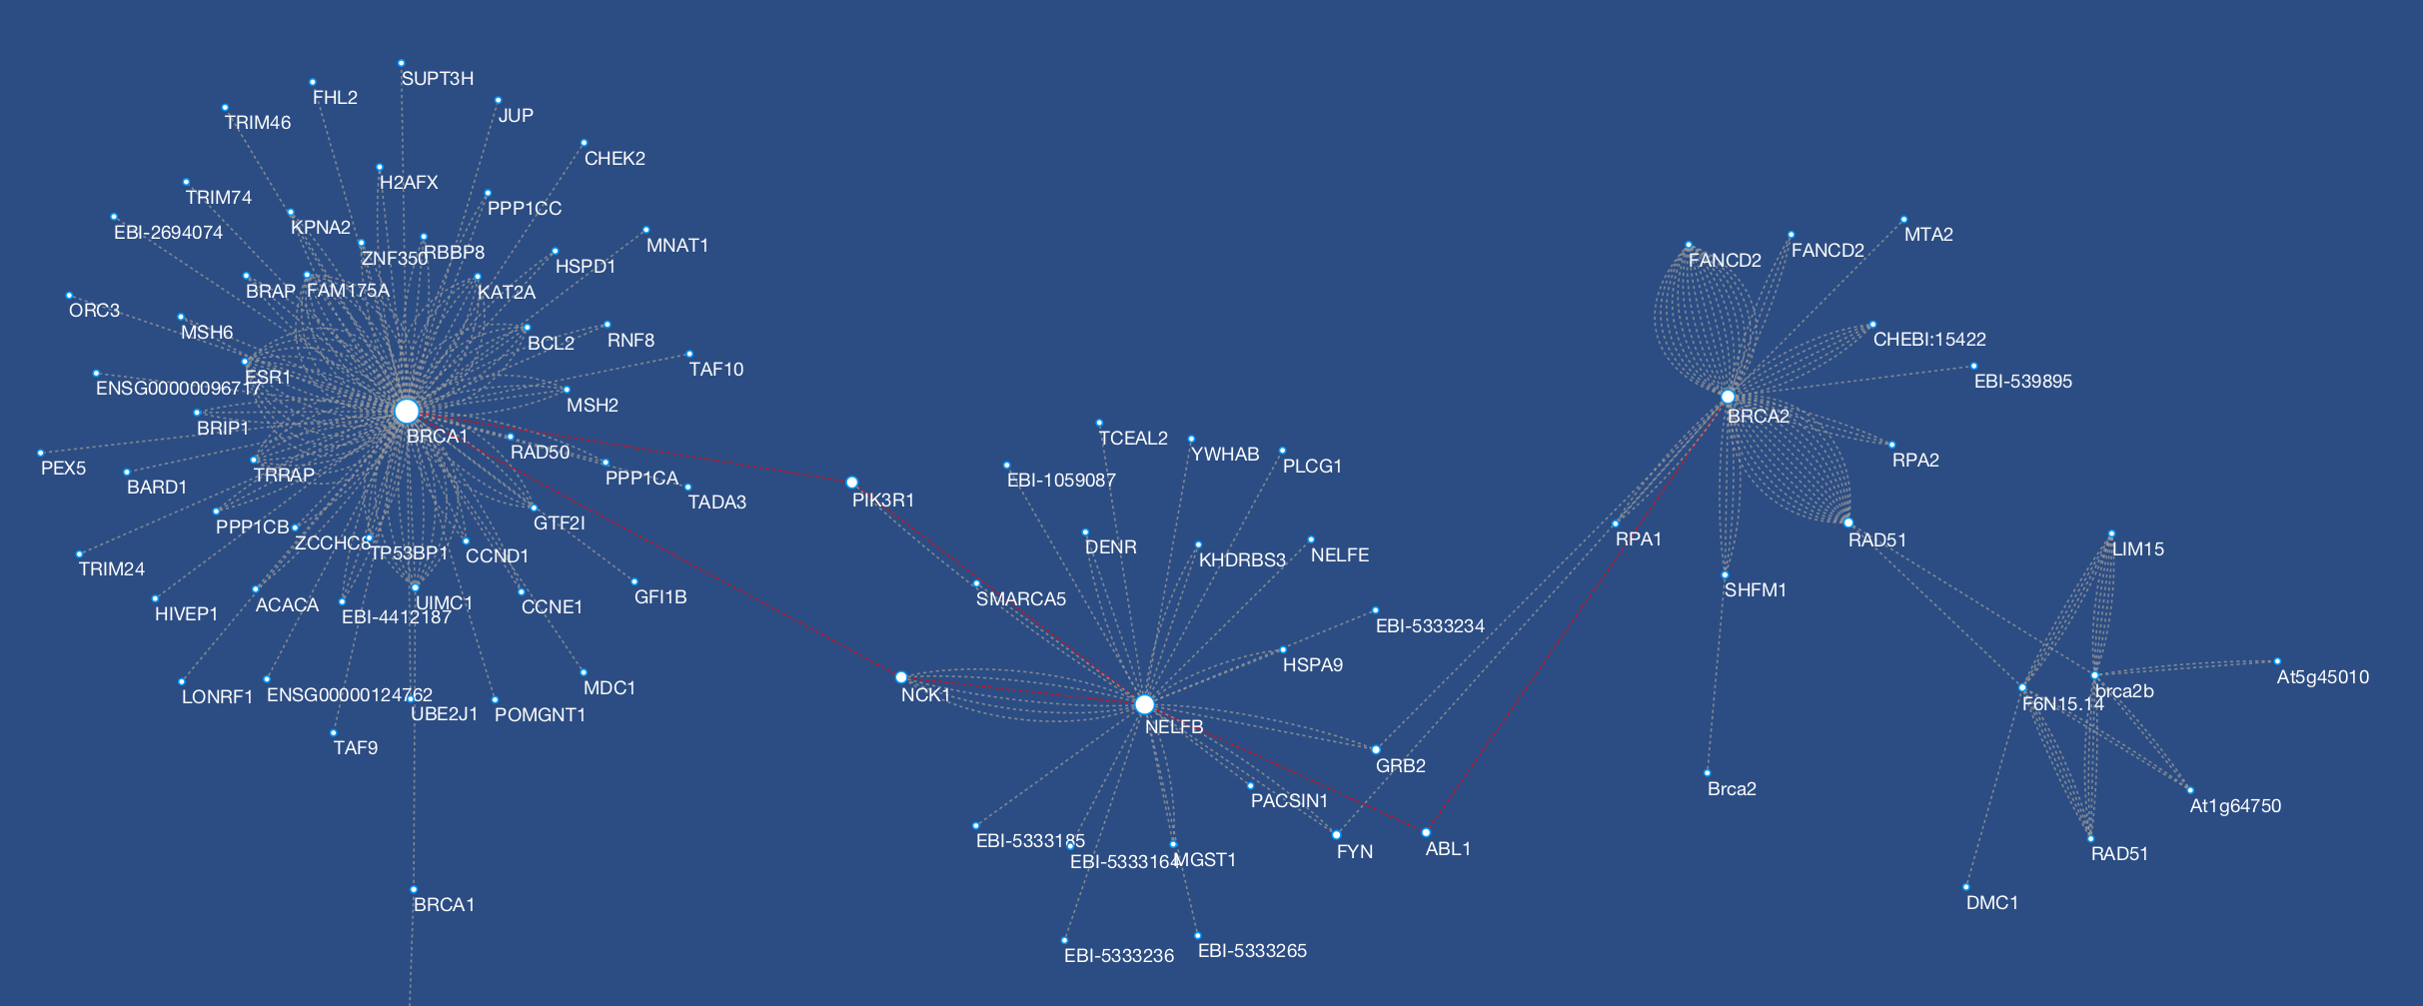
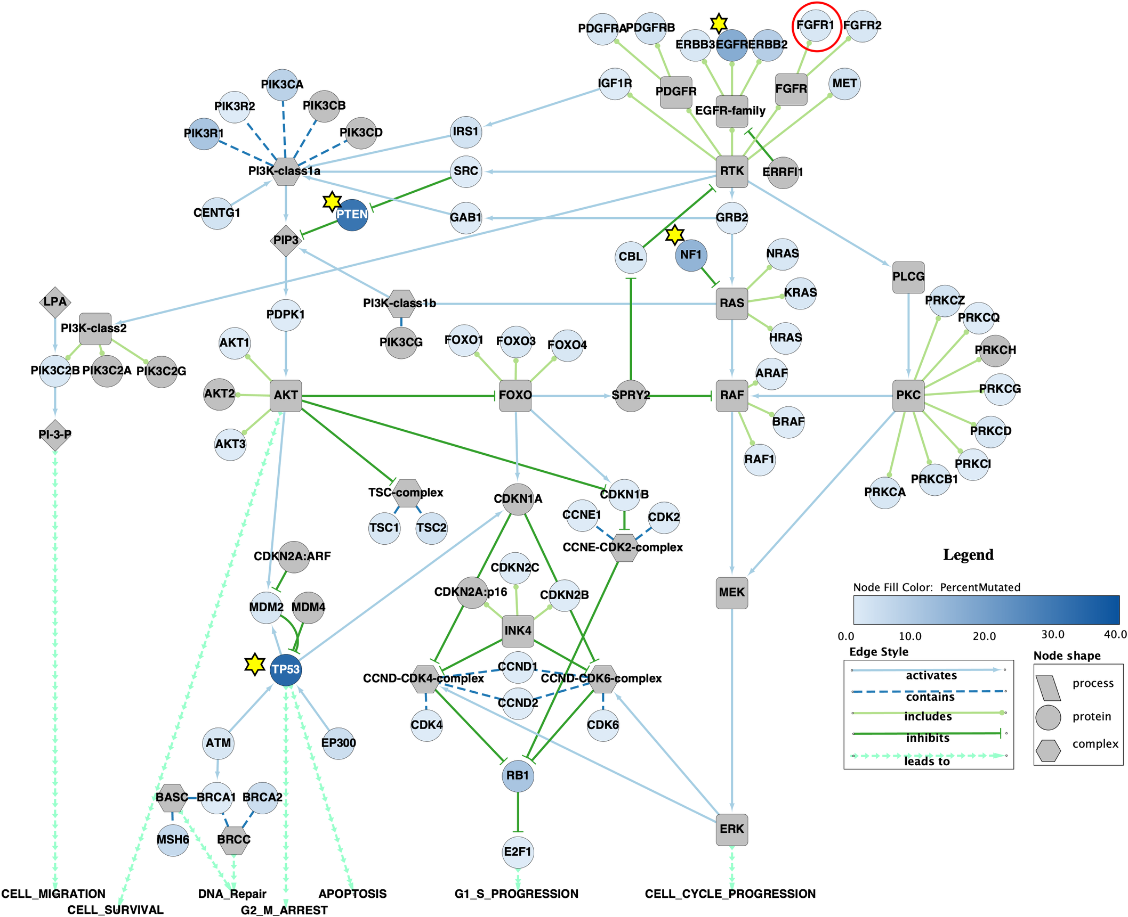
Ball and Stick Models
Cytoscape
Ten simple rules to create biological network figures for communication, PLOS Comp Bio 2019

Slide 5
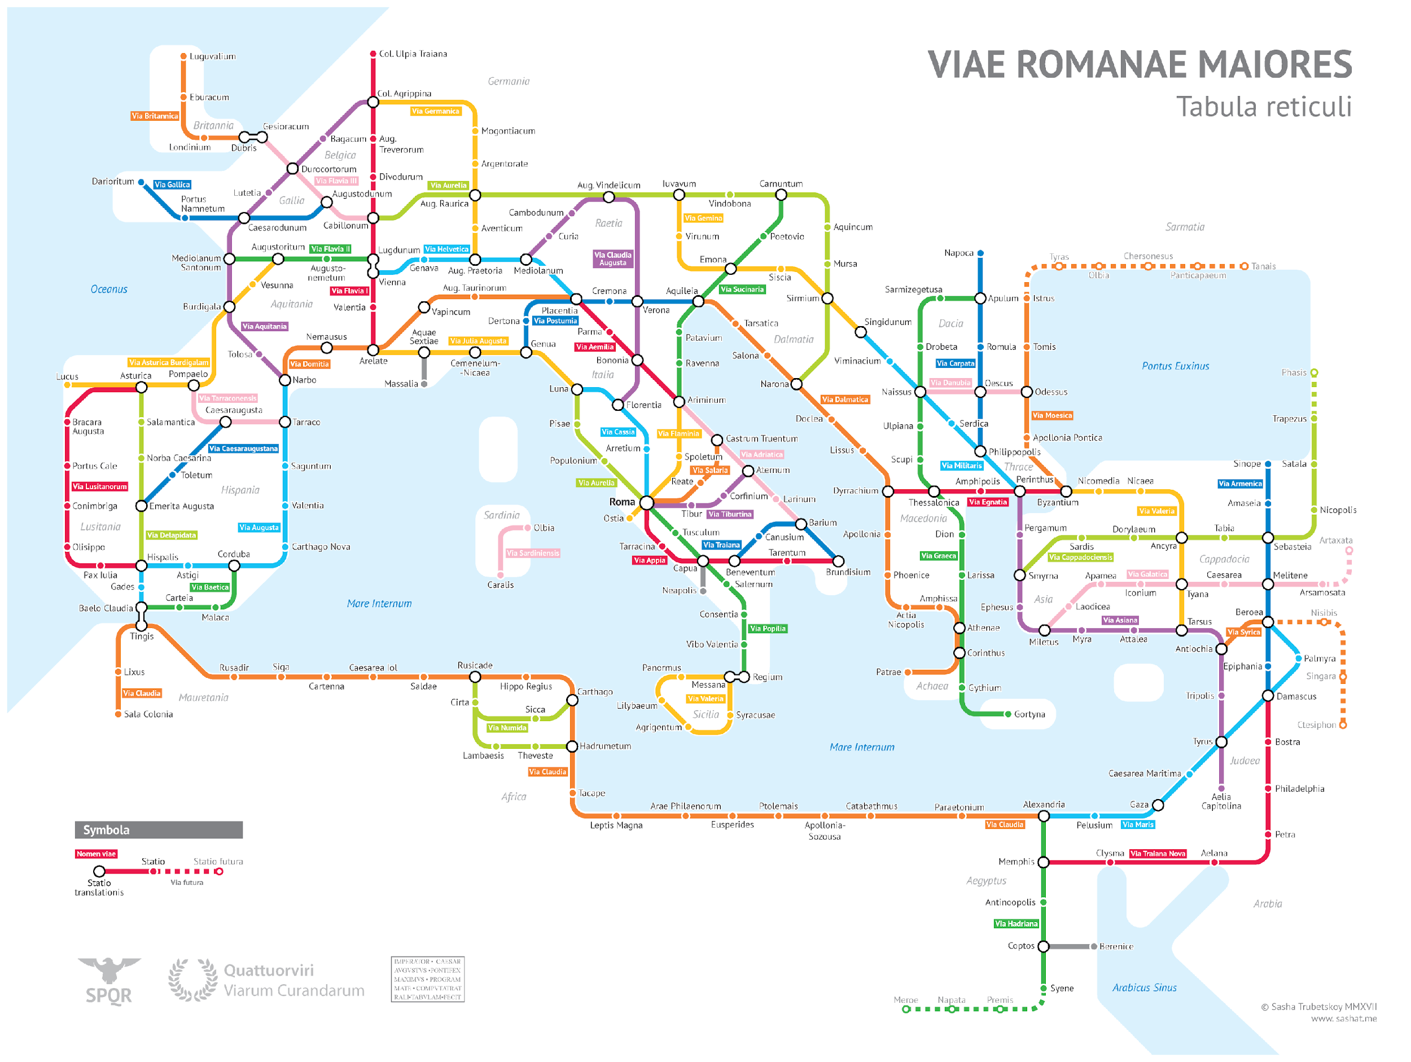
Understanding the Roman Empire from the Road System
https://sashamaps.net/docs/maps/roman-roads-original/

Slide 6
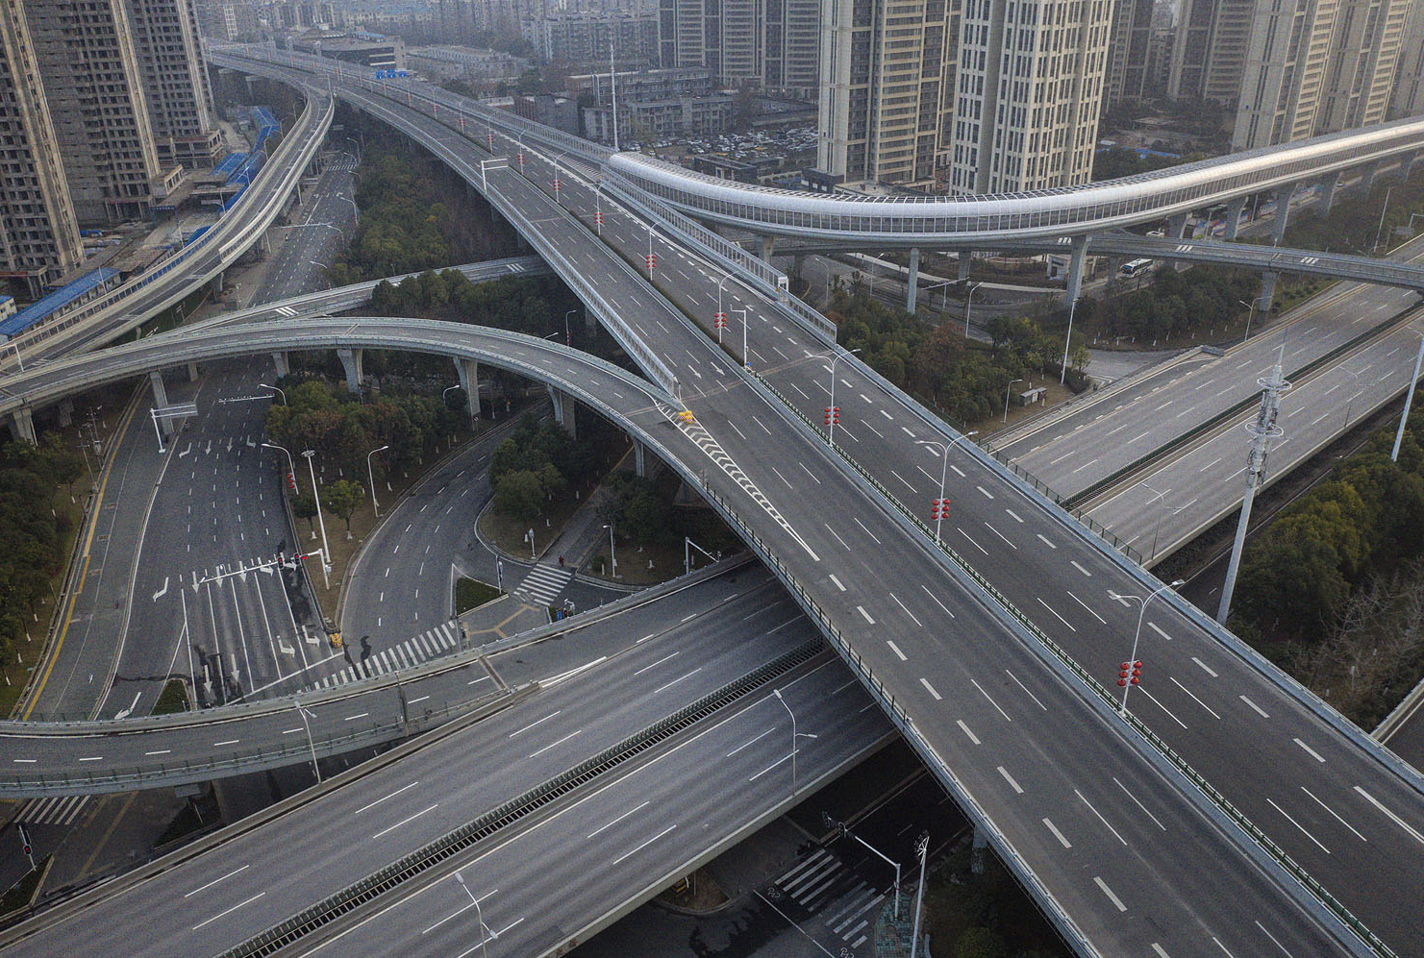
A City with Empty Streets

Slide 7
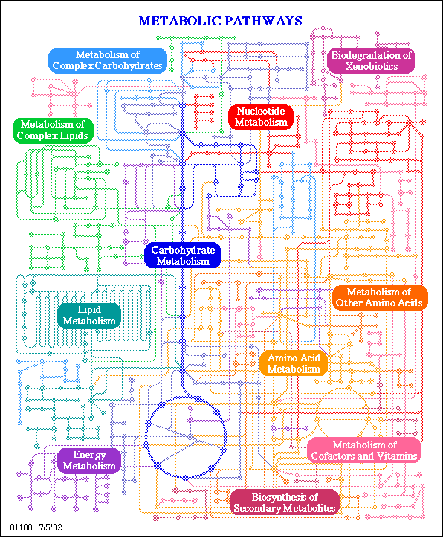
Questions we like answers to
Change the of activity
of an enzyme, e.g. PFK
What happens to the concentration of metabolites, such as pyruvate ?
What happens to the steady-state
flux within the TCA cycle?
If I wanted to maximize the flux through
secondary metabolism, what enzyme
steps should I up or down regulate and by how much?

Slide 8
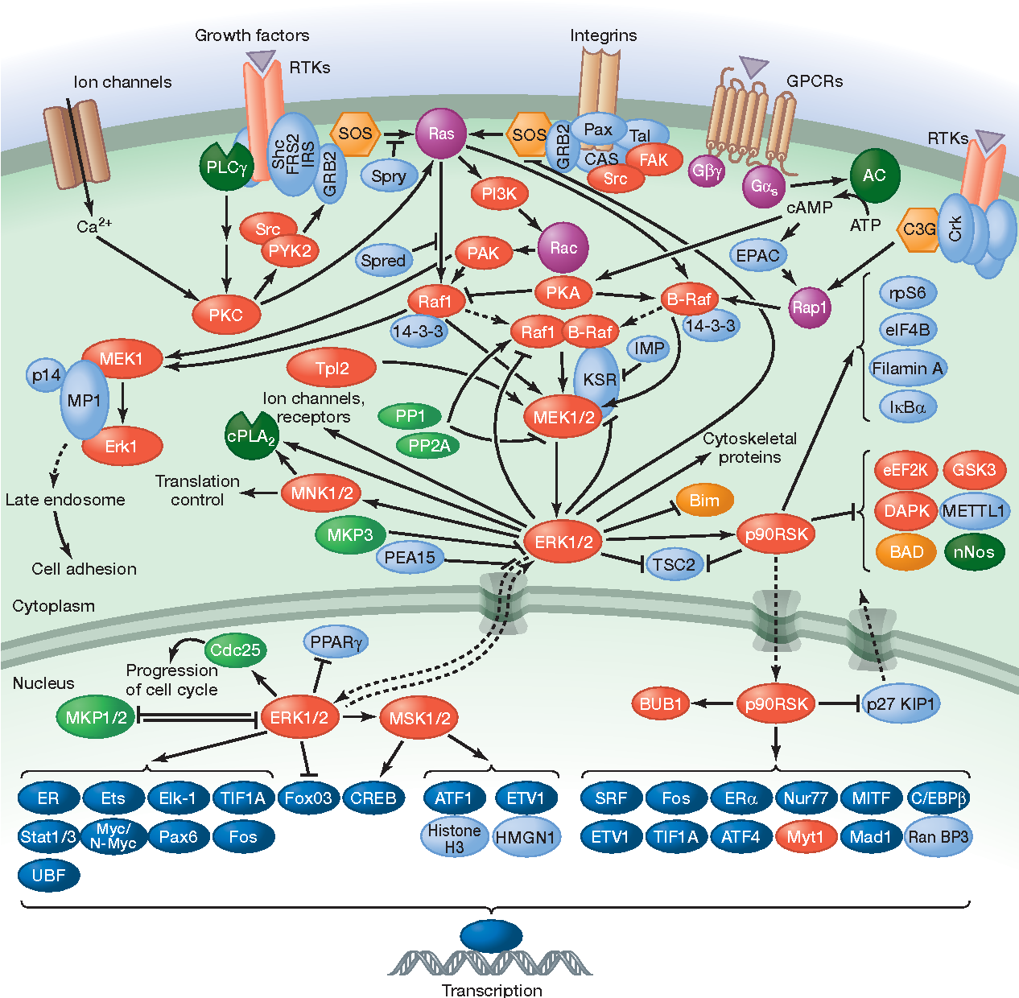
Questions we like answers to
Change the activity
of Spry via a drug
What happens to the concentration of MNK1/2 or PPAR etc?
If we wanted to maximize the effect on ERK2, what combination of proteins should we target? Are there new targets we could pick?
MAP kinase pathways. D. Morrison Published 2012
Biology, Medicine

Slide 9
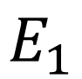
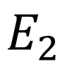
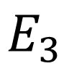
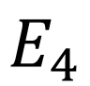
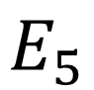
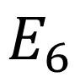
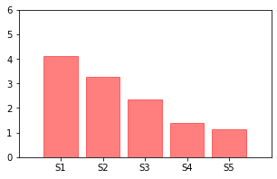
Dynamics is Critical to Understand Cell Biology
Perturbation to this Enzyme

Slide 10
Perturbation to E3: Steps Irreversible
Perturbation to this Enzyme
Show Animation

Slide 11
Perturbation to E3: Steps Reversible
Perturbation to this Enzyme
Show Animation

Slide 12
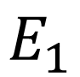
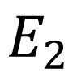
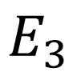
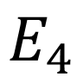
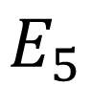
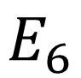
Conclusion: Irreversible Case
Perturbation to this Enzyme

Slide 13
Conclusion: Reversible Case
Perturbation to this Enzyme

Slide 14
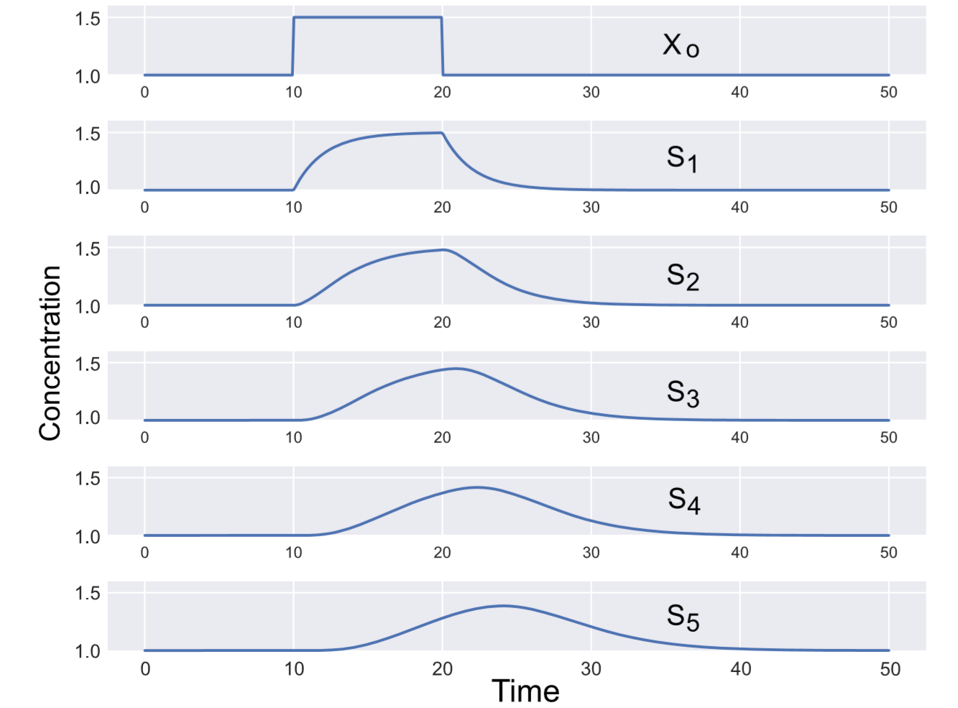
Send a Pulse Down the Pathway

Slide 15
What Determines the Effect of a Perturbation?
Can we estimate the effect of a perturbation without
having to do a simulation?

Slide 16
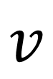
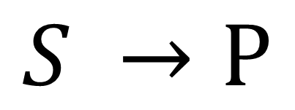
Consider a Single Reaction
How do S and P affect the reaction velocity, v?
It depends on the kinetic rate law.
The trouble is there are 100s of possible rate laws.
Instead we'll look at the sensitivity of v to changes in S or P

Slide 17
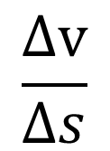
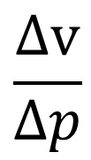
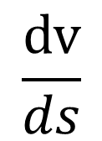
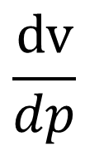
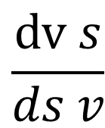
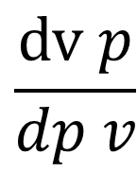
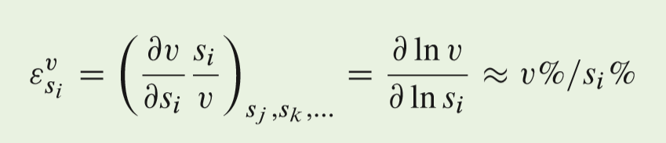
Consider a Single Reaction
Elasticity Coefficients

Slide 18
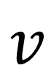
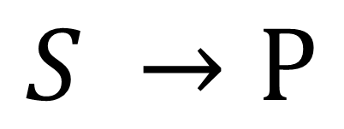
Elasticity Coefficients
Elasticity Coefficients are the unit measures that determine how
perturbations travel through a pathway.
Can be estimated using metabolite and Keq values

Slide 19
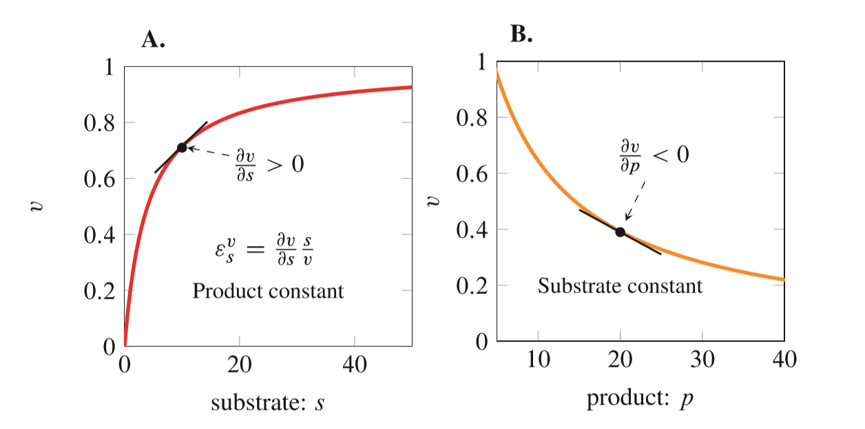
Elasticities – How Perturbations Jump from Step to Step

Slide 20
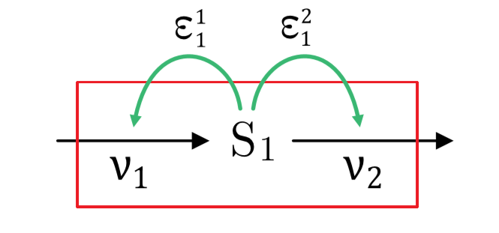
Elasticities Around a Two Step Pathway

Slide 21
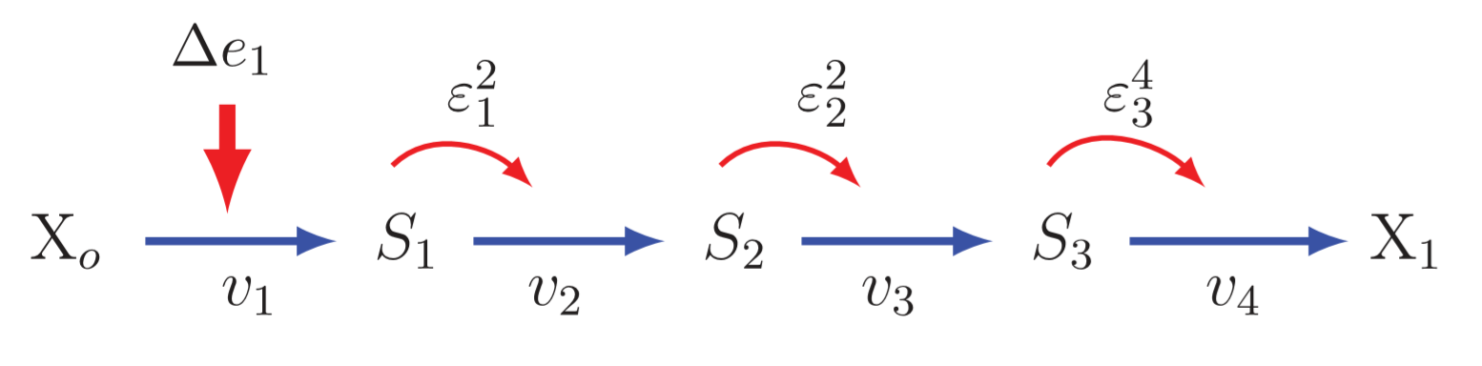
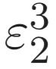
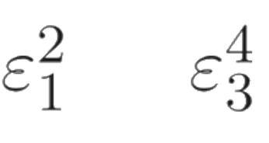
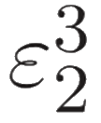
Chain of Causation in Terms of Elasticities
Describing the pictures mathematically in terms of elasticity Coefficients
It much simpler to look at how perturbations affect fluxes.
The percentage change in flux
if a 1% change is made in E1 is

Slide 22
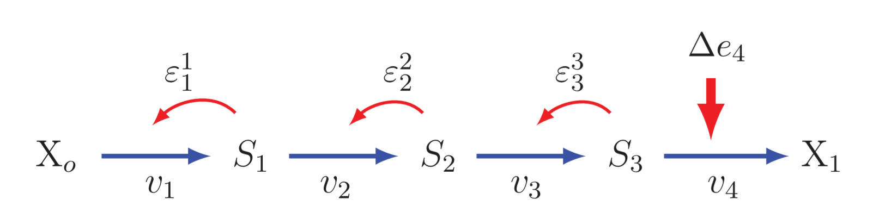
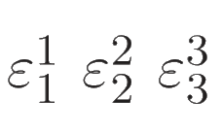
Chain of Causation in Terms of Elasticities
Describing the pictures mathematically in terms of elasticity Coefficients
It much simpler to look at how perturbations affect fluxes.
The percentage change in flux
if a 1% change is made in E4 is

Slide 23
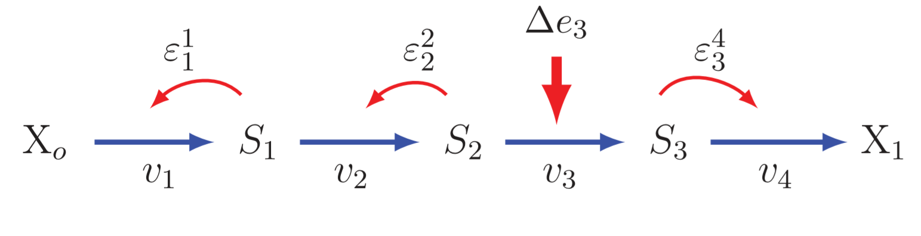
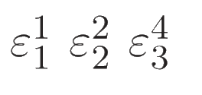
Chain of Causation in Terms of Elasticities
Describing the pictures mathematically in terms of elasticity Coefficients
It much simpler to look at how perturbations affect fluxes.
The percentage change in flux
if a 1% change is made in E3 is

Slide 24
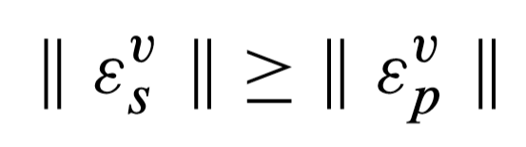

The Impact of Perturbations at Different Points along the Pathway
Important result between the substate and product elasticities
This means it is easier to transmit changes downstream than up stream.

Slide 25
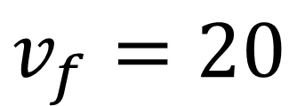
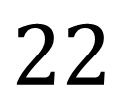




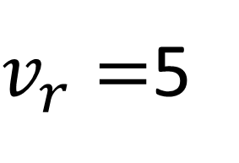
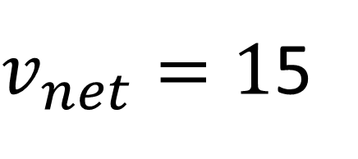
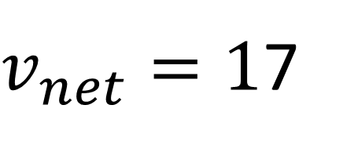

The Impact of Perturbations at Different Points along the Pathway
Increase Substate:
Increase Forward Rate by 10%
5

Slide 26










The Impact of Perturbations at Different Points along the Pathway
Increase Substate:
Increase Forward Rate by 10%
5.5

Slide 27

Distribution of Impact at Different Steps
100,000 simulations using random kinetic constants. The effect of the perturbation
computed in each case.
The influence of a perturbation is highest near the beginning of the pathway.

Slide 28








Chain of Causation in Terms of Elasticities
Slight detour: What about systems with negative feedback?
E1
E2
E3

Slide 29


Chain of Causation in Terms of Elasticities
Slight detour: What about systems with negative feedback?

Slide 30

Chain of Causation in Terms of Elasticities
Slight detour: Two routes for perturbations to travel:
This means that the biggest impact on flux occurs when we perturb the last step.
The regulated step which is traditionally considered the rate limiting step is not important.

Slide 31

Acknowledgements
2019

